Slide 1


JDK and Intellij Installation

Slide 2


Search for JDK download

Slide 3
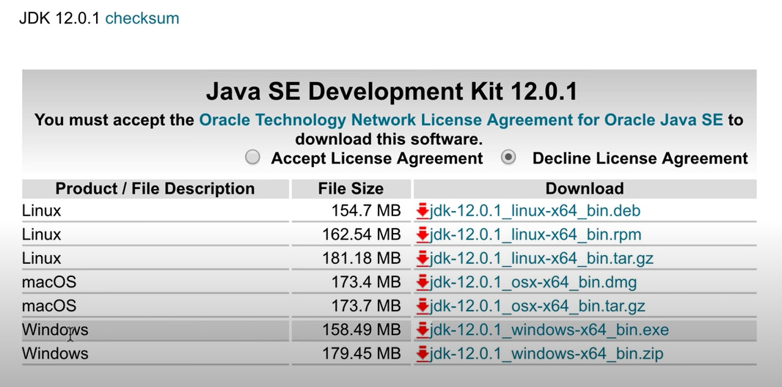
Select the latest Jdk and install it

Slide 4

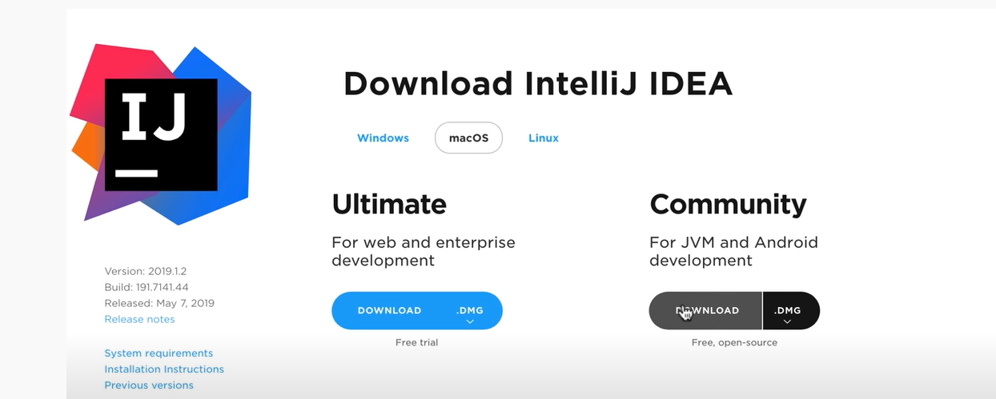
Search for Intellij download and install it
Note: The ultimate edition is the paid edition of IntelliJ. You can also get this for free if you are student. There are videos in YouTube that shows you how to do this if you decide to get the Ultimate version instead but for our course the community edition would be enough.

Slide 5
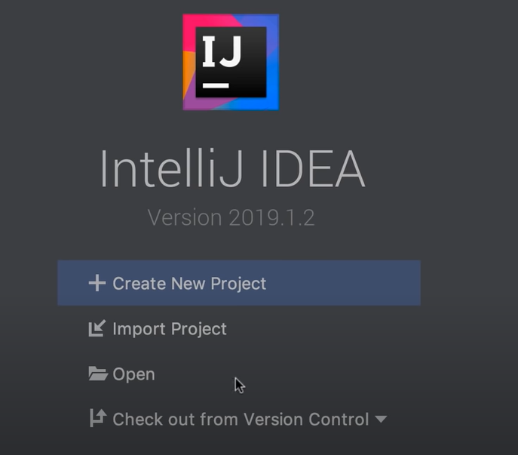
Open Intellij and click create new project

Slide 6
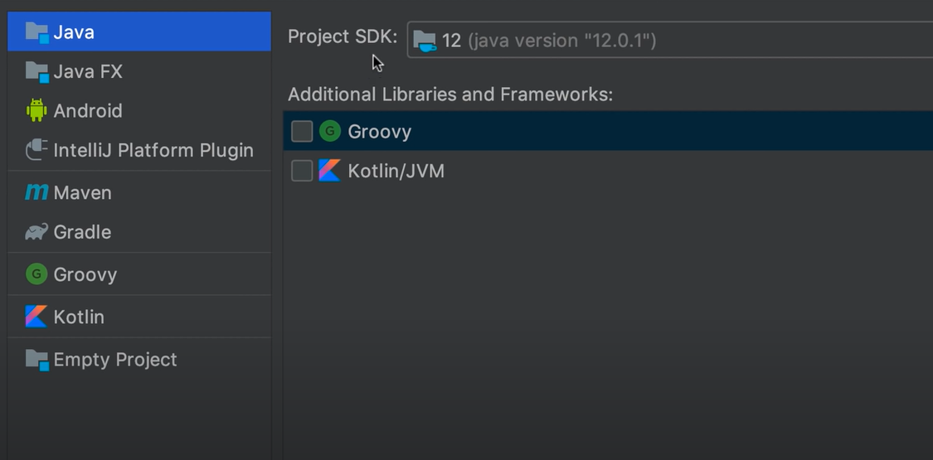
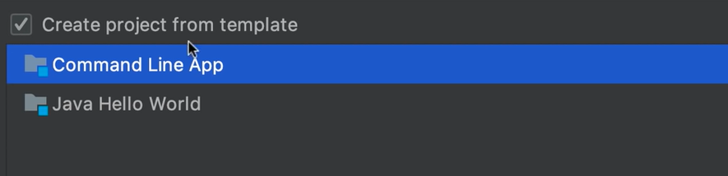
Next steps
Make sure the project SDK is connected on a java version
Select Create project from template and command line app

Slide 7
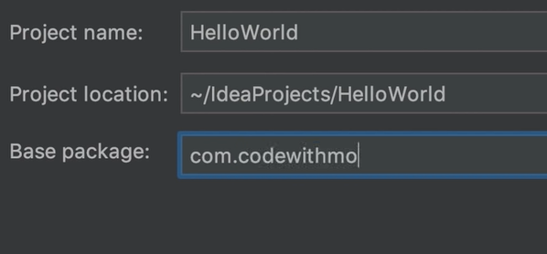
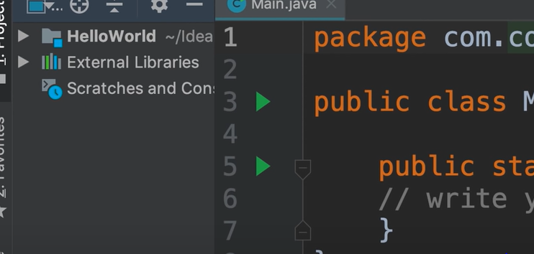
Name your project and package

Slide 8
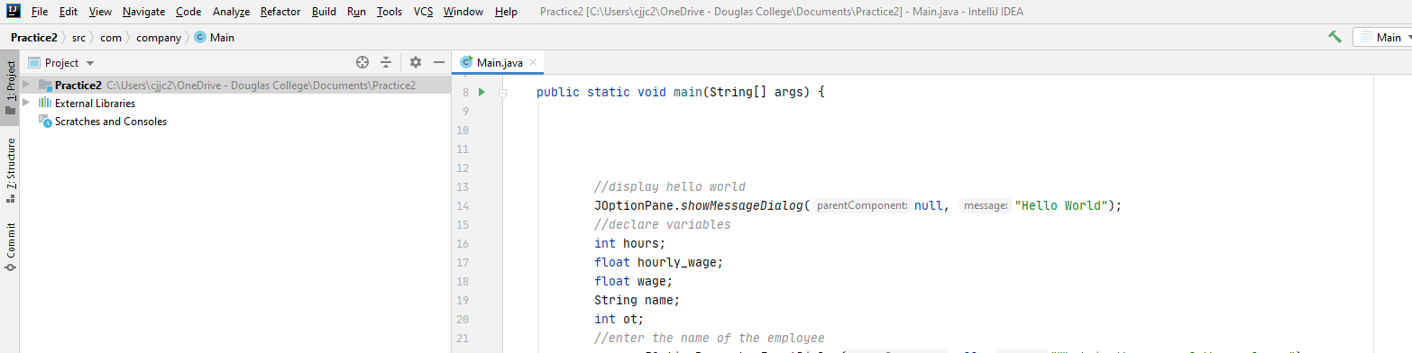
You can now begin to code and run your program.

